Slide 1
Data Structures and Algorithms -3 (25CS2103E)
Plagiarism Detection System using Rolling Hash Techniques
Team 10 | Section 5
Prakshitha Malla (2520030342)
Datla Sri Sai Purna Mahija (2520030261)
Kheerthi Ganta (2520030383)
Under the Esteemed Guidance of
D Swathi Mam, Assistant Professor, CSE

Slide 2
Contents
Abstract
Introduction
Literature survey
Problem Statement and Objectives
Methodology and Flow Chart
Hardware and Software requirements
Results
Conclusion
Future Scope

Slide 3
Abstract
Academic integrity depends on reliably spotting copied content across large document collections. This project builds a plagiarism detection system on the Rabin-Karp rolling hash: polynomial hashes of sliding text windows expose matching passages across multiple documents in expected linear time. Double hashing plus character-level verification removes false positives caused by hash collisions. Every hash table, string routine and array is implemented from scratch, with no java.util. The engine reports similarity percentages and highlights each copied passage for the user.
O(n + m)
expected time per document pair
2 x 32-bit
independent hashes fused into a 64-bit key
0
java.util classes used

Slide 4
Introduction
Plagiarism means presenting someone else's text as your own; checking many documents by eye is slow and inconsistent.
Naive matching compares every window of one document with every window of the other: O(n x m x k) work.
A rolling hash updates the hash of the next window in O(1), so a whole document is hashed in O(n).
We index the window hashes of one document in a custom hash table and look up the windows of the other, giving sub-quadratic comparison.
Rolling update
H(i+1) = ((H(i) - c[i] * B^(k-1)) * B + c[i+k]) mod M
Window k = 25 normalised characters
Pair 1: base 257, mod 1,000,000,007
Pair 2: base 131, mod 998,244,353
Key = (h1 << 32) | h2
Every hit is re-checked character by character

Slide 5
Literature Survey
Technique | Core idea | Relevance to this project
Rabin-Karp (Karp & Rabin, 1987) | Polynomial rolling hash over a sliding window; O(1) update per shift | Core algorithm of our system
KMP / Boyer-Moore (1977) | Deterministic exact matching of a single pattern | Fast, but rerun per pattern; awkward for many documents
Manber fingerprints (1994) | Hashed anchor substrings to find similar files in a file system | Compare documents through hashed substrings
Shingling (Broder, 1997) | Documents as sets of w-shingles; resemblance via Jaccard | Basis of our similarity percentage
Winnowing / MOSS (Schleimer et al., 2003) | Keep the minimum hash per window; guarantees matches above a length threshold | Planned future optimisation

Slide 6
Problem Statement and Objectives
Problem Statement
Develop a plagiarism detection system that identifies copied passages using rolling hash techniques. The application compares multiple documents by generating polynomial hash values for sliding windows of text, handles hash collisions, computes similarity percentages and highlights duplicated passages. All data structures are built from scratch, without java.util.*.
1
Generate rolling polynomial hashes for sliding windows (Rabin-Karp)
2
Compare multiple documents pair by pair through a hash index
3
Prevent false positives with double hashing and verification
4
Compute similarity percentages for every document pair
5
Highlight copied passages in the interface and HTML report
6
Implement hash tables, strings and arrays from scratch

Slide 7
Flow Chart
1. Load documents
Read .txt files or choose them in the GUI
2. Normalise text
Lower-case, strip punctuation, keep index map
3. Rolling hash
Double hash of every k-char window
4. Build hash index
Custom chained table for Document A
8. Report
Similarity % and highlighted text
7. Merge passages
Join adjacent matches into passages
6. Verify match
Compare characters; reject collisions
5. Look up windows
Hash each window of B and probe the index

Slide 8
Results
Similarity on sample documents (k = 20)
Rolling hash vs naive comparison (k = 25)
Document pair | A copied | B copied | Overall
doc1 vs doc2 (copied) | 47.3% | 58.9% | 52.5%
doc1 vs doc3 (partial) | 27.2% | 41.3% | 32.8%
doc1 vs doc4 (unrelated) | 0.0% | 0.0% | 0.0%
doc2 vs doc3 | 0.0% | 0.0% | 0.0%
Chars | Rolling | Naive | Speed-up
3,427 | 2.3 ms | 41 ms | 18x
6,724 | 2.3 ms | 149 ms | 65x
13,479 | 5.6 ms | 650 ms | 116x
27,004 | 6.3 ms | 2,419 ms | 384x
54,244 | 8.2 ms | 9,772 ms | 1,192x
Highlighted output for doc2_copied.txt (copied passages marked)
Modern software engineering relies on many ideas. Data structures are fundamental to computer science because they determine how efficiently information can be stored and retrieved. Students often study trees and graphs as well. A hash table maps keys to values using a hash function, giving average constant time lookups. Testing and documentation are equally important in any project.
Timings measured on the development machine after JIT warm-up; collisions rejected by verification: 0 in all runs.

Slide 9
Hardware and Software requirements
Hardware
Any desktop or laptop PC
Dual-core processor or better
4 GB RAM minimum (8 GB recommended)
100 MB free disk space
Display for the Swing interface
Software
Java Development Kit 11 or later (built and tested on JDK 21)
Windows, Linux or macOS
Java standard libraries only: java.lang, java.io, javax.swing
IDE: IntelliJ IDEA, Eclipse or VS Code
Web browser to open the HTML report

Slide 10
Conclusion
The rolling hash system finds copied passages across multiple documents in expected O(n + m) time per pair, against O(n x m x k) for the naive approach.
Double hashing with character-level verification gave zero false positives in every test.
Hash index, dynamic array, string normaliser and reporter are all written from scratch without java.util.
Similarity percentages and highlighted passages, in the Swing GUI and an HTML report, make the results easy to act on.

Slide 11
Future Scope
Winnowing to keep only selected hashes, shrinking the index for very large corpora
Word-level shingles and stemming to catch light rewording
Support for PDF and DOCX input
Persistent index so new documents are checked against an existing collection
Multi-threaded pairwise comparison
Citation-aware filtering so quoted and referenced text is not flagged

Slide 12

GEO TAG

Slide 13
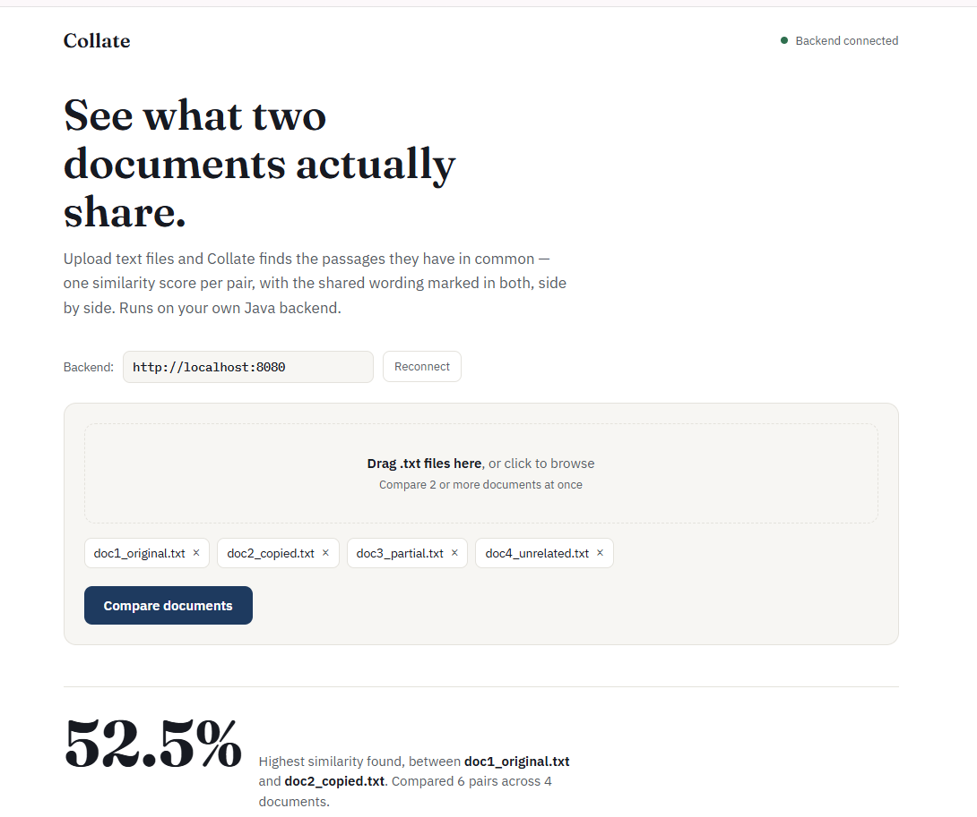
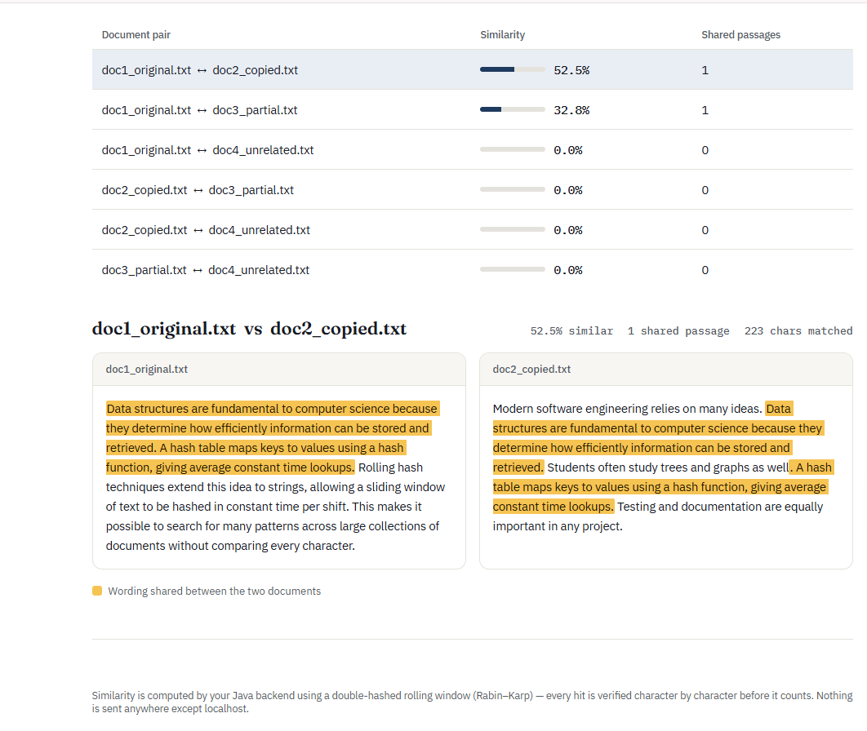
OUTPUT

Slide 14
Thank you

